Slide 1
Mobile Information Literacy
Stacey Wedlake and Karah Lothian
March 2018
Nakuru, Kenya
Notes:
Begin by greeting the class and introducing yourself.
Spend a minute explaining the course title and content. Mobile Information Literacy means you know how to use mobile devices to find and evaluate the quality and credibility of information obtained online, understand how to create and share online information effectively, and participate safely and securely.
Provide time to discuss your background, any experience you have with the information and communications technology, and any other relevant information you wish to share.

Slide 2
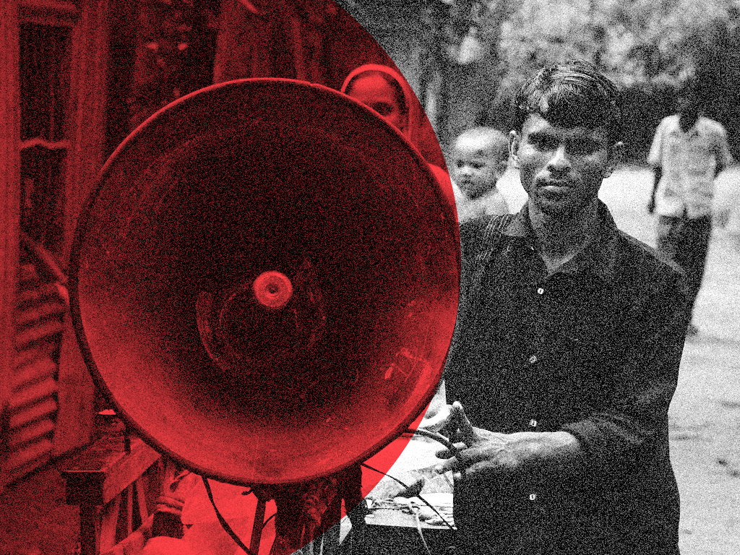
Technology & Social Change Group
explores the design, use, and effects of information and communication technologies in communities facing social and economic challenges.
ICT Information & Communication Technologies
Development social, economic, political
Global Research 50+ countries
Making a difference Improving policy and practice

Slide 3
Overview of course
Day 1
Module 1: Introduction to the mobile internet
Module 2: Security and information searching
Day 2
Module 3: Making smartphones work for you
Module 4: Using library resources on mobile
Notes:
Outline the structure of the course (two days of class will be broken up into 3 hour modules. Each module has a 10 minute break with a lunch break in between the modules. Provide time to address any other administrative issues that need to be brought up before class begins.
Pause to ask if anyone has questions so far.

Slide 4
Module 1: Introduction to the mobile internet and smartphones
15 minutes | Introduction
20 minutes | Icebreaker and Learning Objectives
15 minutes | Applying prior knowledge
20 minutes | Internet and WWW
30 minutes | Mobile Internet: Data vs Wi-Fi
15 minutes | Break
25 minutes | Activity: Perform the Internet
15 minutes | Apps vs browsers
35 minutes | Activity: Exploring the Internet
5 minutes | Debrief
Notes:
The purpose of this class is to learn about the mobile internet: what it is how to use it, and what you can do with it. By the end of this class, participants will have a basic understanding of the mobile Internet that they will be able to build on for the remaining modules of the Mobile Information Literacy curriculum.
Highlight to the participants that the best way to learn mobile information literacy is by learning new concepts and then applying what you’ve learned.
This workshop is designed to be highly interactive to help you learn new concepts and retain what you’ve learned. Say that as a trainer, you are here to help participants learn and to support them. There are no right or wrong answers or questions and there will be no exams. Participants are here to learn and explore, and part of that process means making mistakes so that you can learn from them. Throughout the workshop, encourage participation from attendees, and if something is unclear, please don’t hesitate to ask for clarification.

Slide 5
Icebreaker
In groups, each person should think of five ways they use their phone and write it down.
After everyone finishes, each person will share their five things with their group.
Notes:
Module 1: Smartphone Use: People & Places Part I
Purpose: To understand how attendees currently use their phones in their lives.
Break into groups of 4 - 5
Ask participants to think of five ways they use their phone and write it down. (Example: I use WhatsApp to tell my children when to come home and do their chores.)
After 5 minutes, each person should share their five things with their group.
After everyone has shared, ask for a volunteer from each group to share some of the favorite things share in their group.

Slide 6
Smartphone experiences
I used a smartphone for WhatsApp.
I used a smartphone to withdraw money from my account.
I used a smartphone to record a movie.
I used a smartphone to pay my bills.
I used a smartphone to apply for jobs.
I used a smartphone to access library resources.
I used a smartphone to search for information.
Notes:
Applying prior knowledge
n this activity, the classroom will stand and will separate themselves out into different areas of the room based off of a smartphone feature function. Four corners of the room will designate how familiar/unfamiliar a participant is with using a smartphone for a certain activity. The first corner will represent being completely unfamiliar, the second corner will represent having heard of the function before but never using it, the third corner represents using the function once or twice, and the fourth function represents using the function frequently. After each prompt, also ask if the task can be performed on a feature phone.

Slide 7
What is the internet?
What do people do with the internet?
What do you use the internet for?
Notes:
Internet and WWW
Now that the participants understand ICTs, it is important to review what the internet is. Before providing a definition, facilitate a discussion with participants by asking the following:
Now that the participants understand ICTs, it is important to review what the internet is. Before providing a definition, facilitate a discussion with participants by asking the following:
What is the internet? What do people do with the internet?
What do you use the internet for? Share an example with the group.

Slide 8
The internet is a network of millions of computers around the world connected to each other with phone lines, satellites, and cables. It gives you access to a huge range of information and services and it is growing all the time.
(Mozilla Digital Skills Observatory, The Smartphone EcoSystem)
Image source: Clip Art Panda (http://www.clipartpanda.com/clipart_images/internet-scheme-3412815)
Notes:
Then, provide the following definition:
The internet is a network of millions of computers around the world connected to each other with phone lines, satellites, and cables. It gives you access to a huge range of information and services and it is growing all the time. (Mozilla Digital Skills Observatory, The Smartphone EcoSystem)
Internet Service Providers (ISPs), such as SafariCom, manage connectivity.

Slide 9
What is the World Wide Web (WWW)?
The Web is a way of accessing and visualizing information on the internet. The Web is just a small part of the internet. The World Wide Web, or WWW or just “the Web” is a set of interconnected multimedia documents and resources. A web page is one location on the Web, and a series of web pages is a website.
Notes:
Now, ask the participants what they think the world wide web is. Ask if participants have heard this term before. Solicit any original definitions they may have before providing the following:
The Web is a way of accessing and visualizing information on the internet. The Web is just a small part of the internet. The World Wide Web, or WWW or just “the Web” is a set of interconnected multimedia documents and resources. A web page is one location on the Web, and a series of web pages is a website.
Explain that most people use the term “Internet” to describe both the Internet and the World Wide Web, and in this training, we will too.

Slide 10
How do people in your community access the Internet?
Who can use the Internet?
What restricts people's access?
Notes:
Facilitate a short discussion:
"How do people in your community access the Internet?
"Who can use the Internet?"
"What restricts people's access?"

Slide 11
Wi-Fi
Broadband
Notes:
Mobile Internet: Data vs WIFI

Slide 12
Data
Wi-Fi
Wi-Fi
Broadband
Notes:
Smartphones can connect to the Internet through cellular networks and wifi connections.
Smartphones connect to the Internet to download apps, send emails, and use online services.
These applications and websites live on something called "the web," and the Internet—those wires and cable—connects our computers to the web and those sites and applications.
Explain that as we discussed earlier, using your phone on the Internet you can do many of the same of things you can do on a computer. However, sometimes it’s more difficult to do certain tasks on the phone and often it works a little differently. And some tasks you must a phone - not a computer.

Slide 13
Wi-Fi vs Data
Advantages to Wi-Fi
Advantages to Data
Cost
Coverage
Speed
Quality
“Anywhere”
Notes:
Cost – Wi-Fi is often free or very low cost; there are no roaming charges for Wi-Fi. (example: I can download and watch videos all day long using Wi-Fi at no charge; over cellular, I would easily exceed my data limit.)
Coverage – Wi-Fi is widely available; many homes, businesses, and other locations offer Wi-Fi. (example: This [type of facility] offers free Wi-Fi; […] offers free Wi-Fi; most airports, coffee shops, and retail businesses offer free Wi-Fi; etc.)
Speed – Wi-Fi has significantly faster speeds allowing for more data transfer over less time
Quality – Calls are often clearer over Wi-Fi than cellular (example: [provide personal exp.])

Slide 14
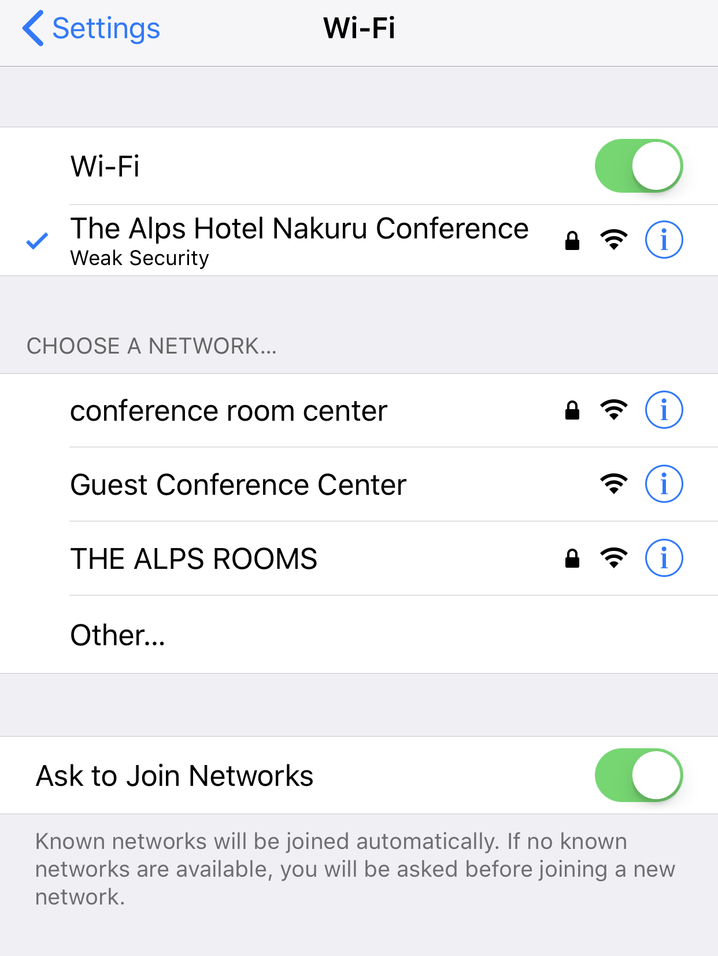
Secure vs unsecure Wi-Fi
Notes:
Next, ask the participants what they think the difference is between secure wifi and unsecure wifi. Then, explain that wifi without a password means anybody can connect to it. Just like when you use any public good, such as a park, all sorts of people can use it for free. This means that there may be people using the wifi that could spy on your information, or track you when you log on to sensitive websites, such as your personal bank accounts or email account. Tell the participants that in order to be secure, it is best to reserve visiting these sensitive websites only when using a secure wifi connection.

Slide 15
Notes:
Finally, you can connect to a website using data that you have purchased. However, browsing using your data can add up quickly, as it will require more air time depending on what types of websites you are browsing.
Ask the participants, which internet browsing is most expensive? Which is the least expensive? Why do they think that is?

Slide 16
Android
To monitor your data usage go to settings > Wireless & Networks > Data Usage
iOS
Cellular > Cellular Data Usage
Notes:
To monitor your data usage go to settings > Wireless & Networks > Data Usage.
You can also change the dates of the “data usage cycle” so you can better monitor how much data you’ve used.
You can also make it so that certain apps don’t use cellular data – only Wi-Fi

Slide 17
Perform the Internet
In groups, spend 10 minutes to create a short skit that shows how either the Internet or cellular network functions. Groups should show, rather than tell, how one of the technology platforms works. Use any of the available materials for your skit.
Notes:
Activity 1.1

Slide 18
Browser
A browser allows you to do just that, browse the internet for websites.
Firefox
(Mozilla)
Chrome
(Google)
Safari
(Apple)
Tor
(Tor Project)
Opera
(Opera)
Edge
(Microsoft)
Notes:
Apps vs browsers
Remind participants that when they connect to the internet using their mobile phones, they are using the mobile internet. Then, share with the participants that they view the internet on their smartphone through a browser. Before providing a definition for participants, write the word on the board and solicit response from participants about what they think a browser is. Then, provide the following definition: A browser allows you to do just that, browse the internet for websites. There are many browsers to choose from, and these are just some of the more common browsers in use: internet explorer (Microsoft), Safari (Apple), Chrome (Google), Firefox (Mozilla), and Opera (Opera) Show the app icons for the different browsers.

Slide 19
Notes:
Web browsers provide a visually-engaging and user-friendly way to browse information via websites on the internet. Take some time to discuss with the participants, including which browsers are they familiar with? How many web browsers to you have on your mobile device? Which do you use? Why?

Slide 20
Activity: Exploring with Smartphones
In groups, get connected to center’s Wi-Fi.
Notes:
Have participants connect to the designated facility Wi-Fi. Emphasize that getting connected to the network is an important first step to continuing on with the remainder of the workshop. Access to the facility Wi-Fi will allow participants to practice downloading and installing apps, a skill that they will need to be familiar with for Module 2. Before beginning, arrange the classroom into groups of about 3-4 workshop participants.
Have participants, in their groups, work together to get connected to the Wi-Fi. Provide the participants with the information necessary to log into the Wi-Fi. Encourage them to help others get connected on their devices. Check in with each group to mark their progress and troubleshoot any issues.

Slide 21
Activity: Exploring with Smartphones
What’s the difference between a browser and an app?
What apps do you have on your device?
What do you use them for?
Notes:
Once participants have logged on to the internet, remind them of the difference between a browser and an application (app). Solicit the class first for an answer, then provide the difference if necessary. Now that participants understand how to access the intent on their phones, participants will practice downloading and interacting with apps.
Applications, or apps for short, are the programs that make mobile devices so powerful. Participants will learn how to download apps and install apps and understand basic app management.
Ask participants
What is an app?
What apps do you have on your device?
What do you use them for?
For each answer, see how many other people use/ don’t use that app.

Slide 22
Activity: Exploring with Smartphones
Be aware of when assessing apps:
Number of downloads
Company or Creator
Reviews
Last updated
Notes:
Emphasize the importance of understanding how to download and manage apps. Explain that you download apps from the Google Play Store. Emphasize that downloading apps from the Play Store is the safest way to download apps. (We’ll explore this issue more later.)
Working in pairs or groups, instruct participants to download an app that you have selected.
Check in with each group to mark their progress and troubleshoot any issues.
At present, there are over 1 million Android and Apple apps available for download. With so many apps to choose from, it can be difficult to assess the credibility and safety of apps. Emphasize the following items to be aware of in assessing apps:
Number of downloads – some apps are imitations or have very persuasive descriptions. For popular apps, participants should see a relatively large number of downloads compared to lookalikes.
Company or Creator – look for familiar names of companies or app creators that have established reputations for quality products and services.
Reviews – browse the lowest-rated reviews to learn about issues that users have noted.
Now that participants have downloaded the apps onto their devices, it is important that they understand how to access the settings on the app. At this point, they will not need to modify the settings, just understand how to find the settings of apps.

Slide 23
Activity: Exploring with Smartphones
What are some options available in settings? What do they do?
Which settings options do you think are important for protecting your information? Why?
Notes:
Emphasize the importance of understanding how to download and manage apps. Explain that you download apps from the Google Play Store. Emphasize that downloading apps from the Play Store is the safest way to download apps. (We’ll explore this issue more later.)
Working in pairs or groups, instruct participants to download an app that you have selected.
Check in with each group to mark their progress and troubleshoot any issues.
At present, there are over 1 million Android and Apple apps available for download. With so many apps to choose from, it can be difficult to assess the credibility and safety of apps. Emphasize the following items to be aware of in assessing apps:
Number of downloads – some apps are imitations or have very persuasive descriptions. For popular apps, participants should see a relatively large number of downloads compared to lookalikes.
Company or Creator – look for familiar names of companies or app creators that have established reputations for quality products and services.
Reviews – browse the lowest-rated reviews to learn about issues that users have noted.
Now that participants have downloaded the apps onto their devices, it is important that they understand how to access the settings on the app. At this point, they will not need to modify the settings, just understand how to find the settings of apps.

Slide 24
Activity: Exploring with Smartphones
Properly close apps – otherwise you might deplete your data, memory, and battery
Deleting apps – always remove apps you no longer use
Notes:
Have the participants work with their groups to find and identify the settings on their devices associated with the app they just downloaded.
What are some options available in settings? What do they do? Which settings options do you think are important for protecting your information? Why?
Check in with each group to mark their progress and troubleshoot any issues.
Explain that simply navigating away or closing an app window does not shut down an app. Many users erroneously believe that apps are closed down because they don’t see them. If apps are not closed down, they can continue to run in the background. In addition, running apps deplete battery life or may use cell data.
Have participants work in their groups to learn how to properly close down apps on their devices as well as on other devices.
Check in with each group to mark their progress and troubleshoot any issues.
Finally, participants should understand how to remove apps they no longer want on their devices:
Have participants work in their groups to learn how to delete apps on their devices as well as on other devices.
Check in with each group to mark their progress and troubleshoot any issues.

Slide 25
Activity: Exploring with Smartphones
How can you use what you learned to interact with apps in the future?
How can you share what you have learned with others?
Notes:
Pause and take some time to answer any questions the participants have as they arise. Be sure to walk around during this activity to serve as a resource for groups that are struggling, or to check in with participants as necessary. At the end, provide some time to debrief with participants. Did they learn anything new? How can they use what they learned to interact with apps in the future? How can they share what they have learned with others?

Slide 26
What did you learn?

Slide 27
End of Module 1

Slide 28
Module 2: Mobile Security and Information Searching
20 minutes | Icebreaker and Learning Objectives
30 minutes | Creating accounts
30 minutes | Activity: Password guessing game
15 minutes | Break
20 minutes | Searching for information on smartphones
30 minutes | Investigating what we find online
30 minutes | Activity: Identifying Mobile Scams
5 minutes | Debrief
Notes:
Introductions
Begin by welcoming the class and introducing yourself. If it’s your first time teaching the participants, provide time to discuss your background, any experience you have with the information and communications technology, and any other relevant information you wish to share.
Outline the structure of the day and provide time to address any other administrative issues that need to be brought up before class begins.
Pause to ask if anyone has questions so far.
Learning Objectives
Introduce to the class that today will focus on creating accounts and passwords and how to search for information.
Often, when you download an app or go to a certain website, you have to create an account. What’s an account?
Who can define what a username is? Who can define what a password is? Why do you think it is important to protect yourself online? Is the internet a dangerous place?
Then, take some time to review concepts from the previous lesson. For example, what is the difference between an app and a browser?
Pause to answer any questions.

Slide 29
Icebreaker
Each group will choose one of the ways they use their phone from the first module icebreaker and then they will act it out.
Choose at least 1 narrator and 1 actor (can have more)
Skits should be short - no more than 1 minute.
Notes:
Module 2: Smartphone Use: People & Places Part 2
Purpose: To get a better understanding of how people interact with their phones.
Instructions
Break into the same groups as Module 1.
Each group will choose one of the ways they use their phone from the first module icebreaker and then they will act it out.
Choose at least 1 narrator and 1 actor (can have more)
Skits should be short - no more than 1 minute.
Example: If you choose, “I use WhatsApp to tell my children to come home and do their chores.,” then one person could be the parent, another be the kids.

Slide 30
Creating accounts
Notes:
What are some of the potential downsides to creating accounts on a website?
Giving your information to someone you don’t know
Some services sell your information to other companies
If the site or app gets hacked, your information could be exposed (why it’s important to have different passwords which we will talk about later).

Slide 31
Creating accounts
Notes:
Tell the class that you just downloaded the app gmail on your phone. You’ve opened the app and the screen says “Sign In.” Ask the class, “what does this mean?”
Explain that some apps require you to make an account to use them. An account is like entering an agreement with a company. The company will ask for information and or money in exchange for you using the app.
When you decide to make an account on a website or an app, what information do you usually need to give?
Name
Email Address
(sometimes) location, occupation
(sometimes) gender, birthday

Slide 32
Creating accounts

Slide 33
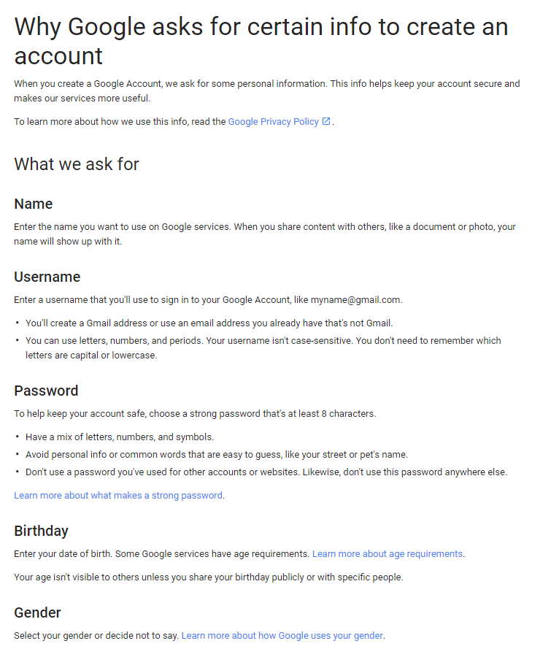
Notes:
Name
Enter the name you want to use on Google services. When you share content with others, like a document or photo, your name will show up with it.
Username
Enter a username that you'll use to sign in to your Google Account, like myname@gmail.com.
You'll create a Gmail address or use an email address you already have that's not Gmail.
You can use letters, numbers, and periods. Your username isn't case-sensitive. You don't need to remember which letters are capital or lowercase.
Password
Birthday
Enter your date of birth. Some Google services have age requirements. Learn more about age requirements.
Your age isn't visible to others unless you share your birthday publicly or with specific people.
Gender
Select your gender or decide not to say. Learn more about how Google uses your gender.
Your gender isn't visible to others unless you share it publicly or with specific people.
Phone number
If you have a mobile phone, this info is optional but highly recommended. Depending on how you add a phone number to your account, your number can be used on different Google services. For example, if you forget your password, your recovery phone number helps you get back into your account.
Learn more about how phone numbers are used.
Current email address
If you already have an email address, we recommend that you add it. This email address can be used for a few reasons, including to:
Help keep your account secure
Help you get back in if you can't sign in, like if you forget your password
Get notifications from Google services

Slide 34
What Gmail asks for
Username
Password
Birthday
Gender
Phone Number
Current Email address

Slide 35
Before creating an account with an app, ask:
"What benefit do you get from having this account?"
"What benefit does the company get?"
“Can I use the app without creating an account?”
"Why does the app want certain information?”
“Should I create this account?”
Notes:
Before creating an account with an app, ask:
"What benefit do you get from having this account?"
"What benefit does the company get?"
“Can I use the app without creating an account?”
"Why does the app want certain information?”
Say, let’s answer these questions about Gmail -
Ask, “What benefit do you get from having this account?”
The ability to send and receive emails with a gmail account. (You’ll find that it’s important to have an email address to use other apps and communicate with others online.)
Ask, “What benefit does the company get?”
Information about you, show you advertisements, easier to use other services
Ask, “Can I use the app without creating an account?”
No, in fact, for email, you want to have an unique, secure account. You don’t want others to impersonate you!
Ask, "Why does the app want certain information?”
It should be apparent and/or the app should tell you why it needs information. Google tells you why it wants certain information. (That doesn’t mean it won’t use the information for other purposes! Unless it explicitly says so).
Ask, “Should I create an account?”
Reiterate that different apps will require different accounts. You’ll want to ask the questions every time you need to create an account.

Slide 36
Activity: Password game
Make up a password for each app and write it on the back of the app.
DON’T USE YOUR REAL PASSWORDS!
Notes:
Explain to the participants that there are many great things you can use the internet for, but it is important to remember the internet is open to everyone in the world. Therefore, just like in the real world, the internet should be treated like a large, public park. Safety is important on the internet, just like it is important in any large public area. This activity is meant to have participants understand why a single password makes their accounts unsafe.
Give each participant five small pieces of paper. Each paper should have the name or logo of a popular app or service.
Invite participants to make up a password for each app or service and to write it on the back of the card. Be sure to help anyone who needs it. Make sure you tell participants to make up passwords, not to use their real ones.
Collect the cards and jumble them in some kind of container.
Ask the participants to take turns picking a random card, reading the password to the group, and leading a discussion to figure out who wrote that password.
Play until several passwords have been correctly guessed. Then move on to facilitate a discussion about password security as described below.
As you play, it should become clear that passwords made up of personal information (like names or dates) and repeated passwords make it easy to guess to whom those passwords belong. Explain that the reverse is also true - impostors can easily break passwords made up short passwords made up of sequential numbers (like 1234) and they can guess passwords that are made of simple words, as well (like “mydata”). Impostors can use what they know about you to guess passwords based on important dates in your life (such as birthdays or anniversaries) or the names of people (including celebrities and sports teams) or places you know.

Slide 37
How to create stronger passwords?
keep passwords simple, long, and memorable
phrases, lowercase letters and typical English (or your local language) words work well.
Notes:
In the past, experts suggested special characters and a mix of lower and uppercase letters. However, what’s most secure is to create a long, memorable password.
For example, a good password would be “mygrandmaboughtmemyfavoriteshirt”

Slide 38
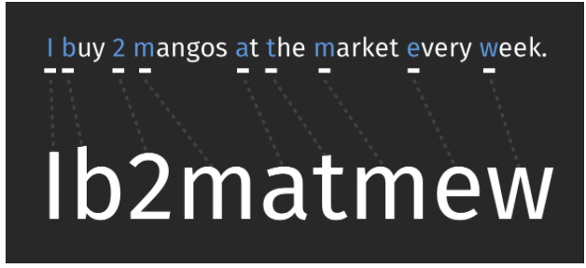
Another way to create passwords
Notes:
Another way to create a good password is take a sentence like “I buy 2 mangos at the market every week” and use the first letter of each word to create a password.
Sometimes sites have specific rules about passwords. For example, the password must have upper and lowercase letters or must use a number or “special character.”

Slide 39
Comic from xkcd: https://xkcd.com/936/

Slide 40
Searching for information
Using only my phone, how would I find the population of Nairobi?
Notes:
Remember from Module 1 that websites are simply a way to visualize information that is on the Internet. There are many different types of websites, such as social media websites like Facebook, news websites such as [use local example], web logs or “blogs” for short, reference websites such as merriam-webster.com, collaborative knowledge-based websites such as Wikipedia, and more.
One particular type of website is especially useful for simply searching the Internet for information: search engine websites.
Search engines are code, or algorithms, that take your requests for information and comb through databases of information and websites that have been indexed to give you a list of websites and information resources that might be relevant.

Slide 41
What search engines have you used?
Notes:
Can you name any search engines you might have used?
Take answers from several participants and then list some common search engines.
One of the most popular search engines is Google. Tell the participants that you can get information on places, jobs, cooking recipes, songs, news, and information for school. Ask someone how they’ve used Google Search. Be sure to ask for specific examples.
Ask trainees to open the Google App on their phone and search for something. Have them use the different tabs (such as images) to see different search results.

Slide 42
Investigating what we find online
What are some popular internet stories that you wonder about?
How can you figure out if a story is true?
Notes:
What are some popular internet stories that you wonder about? These could be something shared on WhatsApp or something you read in the newspaper.
Make a list of the stores on a sheet of paper.
Ask the class, how can you figure out if a story is true? List their responses.

Slide 43
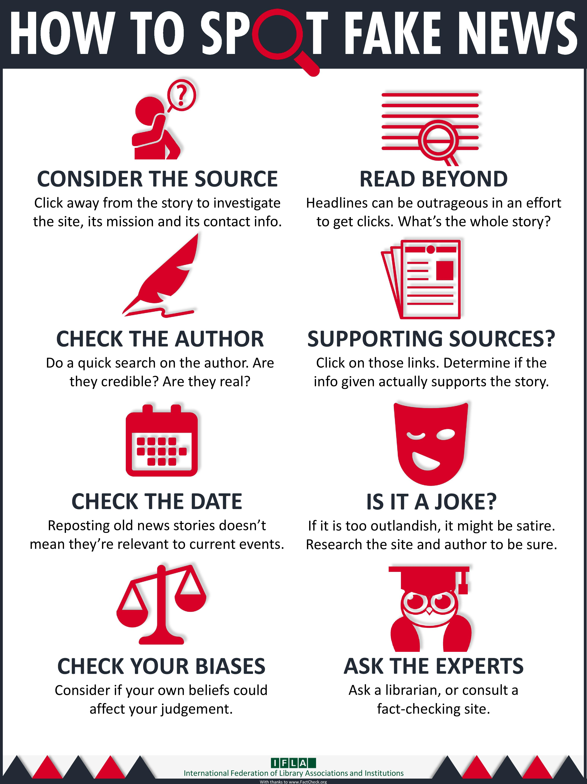
Notes:
Then have them break into teams of 2-3 people to investigate those stories. You can assign particular stories to particular groups if you want or let every group investigate all the stories or just the stories that interest them.
After 10-15 minutes of investigation, bring the whole group back together. Ask each team to share one investigation with the whole group and to explain why they think the story they investigated is trustworthy or not. What was the reasoning that you used to investigate?
Use the last 5 minutes of this activity to run a short, reflective conversation using questions like:
What do trustworthy stories often have in common with one another?
What do untrustworthy stories often have in common with one another?
What are some of the ways authors of untrustworthy stories use to trick people?
Are all pictures and videos trustworthy?
What advice do they have for new internet users about staying away from untrustworthy stories and sites?

Slide 44
Resources for checking fake news
Africa Check: africacheck.org
Snopes: snopes.org
Images
www.tineye.com
Images.google.com
App: Fake Image Detector (Andriod)
App: Veracity – Reverse Image Search (iOS)
Notes:
Then have them break into teams of 2-3 people to investigate those stories. You can assign particular stories to particular groups if you want or let every group investigate all the stories or just the stories that interest them.
After 10-15 minutes of investigation, bring the whole group back together. Ask each team to share one investigation with the whole group and to explain why they think the story they investigated is trustworthy or not. What was the reasoning that you used to investigate?
Use the last 5 minutes of this activity to run a short, reflective conversation using questions like:
What do trustworthy stories often have in common with one another?
What do untrustworthy stories often have in common with one another?
What are some of the ways authors of untrustworthy stories use to trick people?
Are all pictures and videos trustworthy?
What advice do they have for new internet users about staying away from untrustworthy stories and sites?

Slide 45
Activity: Online scams
What is a scam?
What are examples of offline scams?
Notes:
Online scams can come in many shapes and forms. You may encounter them on a website, in an email message, including a type of scam called phishing, or in a pop up window.

Slide 46
Two types of scams
Mobile Spam
Junk email, calls, texts that you didn’t request
Can include fake links for you to click
May ask you to call a fake phone number
May ask you to transfer money
Mobile Phishing
Claims to be from an organization that you’ve heard to win your trust
If includes a link - leads you to a fake website
Asks for your personal information
Sort into three categories: spam, phishing and legitimate

Slide 47
“Think more, share less” -Jevin West, University of Washington Information School
http://callingbullshit.org/

Slide 48
What did you learn?

Slide 49
End of Module 2

Slide 50
Module 3: Making mobile Internet work for you
190 minutes | Topics covered
15 minutes | Icebreaker and Learning Objectives
30 minutes | App privacy basics
30 minutes | Activity: Credibility and security for apps
20 minutes | App security basics
15 minutes | Break
40 minutes | Activity: Exploring local apps
30 minutes | Smartphone exploration
5 minutes | Debrief
Notes:
Outline the structure of the day: Before lunch, class will last approximately 3 hours including 10 minute break in between. Provide time to address any other administrative issues that need to be brought up before class begins.
Introduce to the class that at the end of module, the class will have a better understanding of the different ways they can use their smartphones to support their livelihoods and improve their lives.Explain to the participants that this module will be very hands-on, and that for the majority of the lecture the participants will be working in groups or by themselves to apply what they have learned about what their smartphone can do and how their smartphone can work for them.
Pause to answer any questions.
Take some time to review content from the previous module. Does anyone have any questions from the day before?

Slide 51
Icebreaker
Each group chooses a fake news story
On large piece of paper, answer the following questions:
In your experience, how does a fake story spread across the internet in Kenya? (Who shares it first? Where does it go? etc.)
What apps, websites, people, or traditional media might be involved in its dissemination?
What strategies do you use to determine if the news is real or fake?

Slide 52
App security basics
Review:
Before you create an account what should you do?
When you download an app, you agree to share information with the app – even if you don’t create an account.
Notes:
Before we explore apps further, we’re going to review some safety and privacy steps you should take before downloading and using apps.
Earlier, we talked about when you create an account, you agree to share information with the apps. Can someone review what we talked about and what you should do?
When you create an account, you agree to share certain information. However, just by downloading app, you agree to share information with the app - even if you don’t create an account.

Slide 53
Apps designed to trick you
Notes:
The best protection is for you not to download bad apps. Some apps are created to trick you. For example, if you want to download Facebook Messenger in the Google Play store, you’ll see several apps that are designed to look like Facebook Messenger. If you took a closer look and looked at the description, you would see that it’s not the app you’re looking for.
Using the steps we used earlier, looking at description, reviews, etc will help prevent you from downloading bad apps. To protect yourself, only download apps from the Google Play Store and read carefully before you download. And if you no longer use an app, delete from your phone.

Slide 54
Notes:
Before you download an app, in the Play store, you can view “the permissions” you agree to give the app

Slide 55
Notes:
. Here’s the permissions for “WhatsApp.” (Instructor’s note: Go here, scroll down to “view permissions.”) Does anything surprise you? Is there anything you don’t understand? (An alternative or an addition - look at the permissions from the app downloaded in the previous activity).

Slide 56
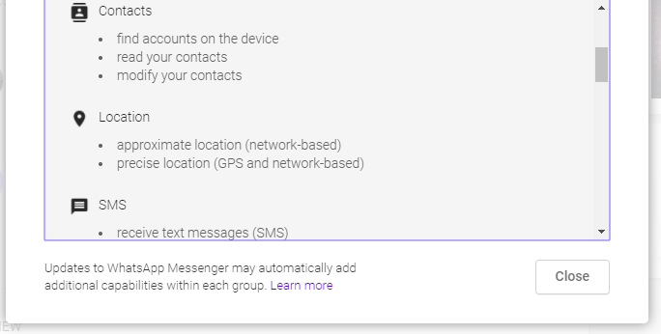
Notes:
These permissions can be really confusing. Be there’s some things to watch for:
Location/GPS
Accessing contacts
Ask yourself why the app would need access to these parts of your phone.

Slide 57
Notes:
Let’s look at Words with Friends permissions:
This app asks access to your identity, contacts, and location - why?

Slide 58
Activity: Evaluating an app for credibility and security
In groups of 2 -3, search for a ledger app to keep daily records of sales on the Play store. (Look at several options.)
Check the description, comments, and ratings to help in decision.
Look for any safety or privacy concerns in permissions.
Choose the app that you think is the best based on its description, features, ratings, and size.
Once you find a safe app, download the app.
Install and try it out.
Notes:
Explain to the participants that this activity is designed to help them understand how to download and use apps, and how determine if the app is of high quality and safe for use.
Say to the participants that this next scenario is hypothetical, and a way that participants should consult applications to help them solve a problem. In this scenario, the students will think of ways they can use a phone to help in running a business.
Provide this scenario for the class:
One respondent sells jerrycans of water. She has a ledger that she would use to keep daily records of sales. However, she has heard that she can use an app to keep the ledger if she downloads it from the Google Play Store. This would help ensures that her records are always available since the app backs up to the cloud where she can always get at her information.
To help this business-owner problem-solve and find an app that works for her, ask participants (in pairs) to:
Search for a ledger app on the Play store (use the search bar and categories for discovery).
Emphasize that you’ll want to look at several options - just because a certain app appears first, doesn’t mean it’s the best fit.
Check the description.
Check the comments and ratings to help in decision.
Look for any safety or privacy concerns.
Check the app size.
Choose the app that they think is the best based on its description, features, ratings, and size.
Download the app.
Install the app.
Test the app with data that participants make up and put into the app.
While the pairs search, go around the room and check-in on the pairs and provide guidance as needed.

Slide 59
Activity
How did they choose their app?
Did it work the way they expected from its description and ratings, or was it better or worse than they expected?
Was the app difficult or easy to install and use?
Could the participants use an app like this in their own lives or work? If so, how would they use it?
Notes:
Before moving on, use the last 10 minutes of the activity to ask each pair to share the following:

Slide 60
App security basics
Malware is a type of computer virus that intentionally damages a computer or smartphone.
https://www.standardmedia.co.ke/business/article/2001255416/why-your-vital-mobile-data-is-at-increased-risk
Notes:
Now that you know what permissions you should watch for, you also need to keep safe from bad apps. Some apps are created to trick you into downloading them and can lead to malware and viruses on your devices that can cause problems in your device and compromise your information and security.
Explain that some apps are created to trick you into downloading them, and that you could inadvertently download malware that steals information from your phone including your PIN and bank information. Earlier, we talked about SPAM and Phishing. Ask is anyone familiar with the term malware?
Malware is a type of computer virus that intentionally damages a computer or smartphone.

Slide 61
Google Play Protect
Only download apps from the Google Play Store
Check for Google Play Protect
Settings > Google > Security > Google Play Protect.
Notes:
As mentioned earlier, you should only download apps from the Google Play Store. All apps in the Google Play Store are checked for security issues. Now, this isn’t perfect, but it helps. Android has has a feature called “Google Play Protect” that will check all of the apps on your phone for security issues. To make sure Google Play Protect is on your phone, go to Settings > Google > Security > Google Play Protect.
Take time for participants to check their phone for Google Play Protect.

Slide 62
Keep apps up-to-date
Google Play Store
Menu > Settings > Auto-update apps
Windows
Settings > Applications > Store > App updates
Apple
Settings > [your name] > iTunes & App Store.
Auto-update apps over Wi-Fi only
Notes:
It’s also important that you keep apps up-to-date. Apps will routinely get updated to protect against new viruses and malware. Show everyone how to update their apps -
Open the Google Play Store app
Tap Menu Settings.
Tap Auto-update apps.
Select an option:
Auto-update apps over Wi-Fi only to update apps only when connected to Wi-Fi.
Explain that setting the apps to auto-update only over Wi-Fi will save data costs.

Slide 63
Settings to protect privacy
Android settings:
Settings → Connections → turn off all
Settings → location (off)
Settings→ more → Security
Password
Encrypt device
Device administrators
Unknown sources (uncheck)
Verify apps (check)
iOS settings:
Settings → Touch ID & Passcode
Settings → Spotlight Search (off)
Settings → Keyboard → Predictive Text (off)
Settings → Keyboard → Enable Dictation (off)
Settings → Privacy → Location Services (Only give access where necessary)
Settings → Privacy → application data requests (review)
Settings → Privacy → Diagnostics & Usage (don’t send)
Settings → Privacy → Advertising → Limit Ad Tracking
From the Library Freedom Project
Notes:
Here’s some additional steps to protect your privacy on your phones, your data, and your privacy.

Slide 64
Activity: Exploring local apps
Kenya Traffic offences guide
Kenya Map
Okoa Loan
Mdundo free music
Date Kenyans
Mbegu choice
mkulima young
National Anthem of Kenya
Kenya Constitution
M-farm
i-cow
Mpesa
NTSA
i-Tax
OLX
Kilimall
Jumia online shopping
Mshwari mobile loan
Akili’s Alphabet kids app
Notes:
This activity is designed to give participants a chance to learn about Kenyan apps.
Show the list of pre-made Kenyan apps. Ask if the list is missing any apps that participants have heard about. If so, add the app to small piece of paper.

Slide 65
Activity: Exploring local apps
As a pair, pick one app and go to the Google Play store and look up that app on their phone.
Check the description. What does this app do?
Check the comments and ratings. What do people think of the app?
Look for any safety or privacy concerns. Do the permissions make sense for what the app does?
Check the app size. How much space is needed on your phone?
(If you think it’s safe to do so) Download the app.
Install the app.
Test the app. How well does it work?
Write your notes on a large piece of paper.
Notes:
Go around the room and have everyone take a piece of paper with an app name. Pair people up. As a pair, pick one app and go to the Google Play store and look up that app on their phone.
Check the description. What does this app do?
Check the comments and ratings. What do people think of the app?
Look for any safety or privacy concerns. Do the permissions make sense for what the app does?
Check the app size. How much space is needed on your phone?
(If they think it’s safe to do so) Download the app.
Install the app.
Test the app. How well does it work?
On a large sheet of paper, have the pair write the name of the app and take notes on what they discover. After they finish analyzing one app, they can move onto the next app. Tape the paper with the notes about the app on the wall of the room. If they finish with both apps before everyone else is done, have the pair choose another app.
With 10 minutes left, ask participants to share any thoughts or discoveries they had while doing the exercise. Ask for the volunteers to present an app to the rest of the class. Encourage the participants to check out all of the findings on the apps during the rest of the day.

Slide 66
Smartphone exploration
What do you want to accomplish using your phone using an app?
Notes:
Ask the class what respondents are interested in accomplishing using their phones. Write down their ideas and suggestions on a large piece of paper in the front of the room. Then, working in pairs, have participants work on accomplishing one of their goals. As the instructor, move around the room helping people as needed. Remind the class -
Check the description.
Check the ratings (check how many rated it).
Check the reviews.
Check the phone storage(check app size ).
Check privacy permissions
Download and install app.
Check for existing updates.
Adapted from Mozilla | What’s Possible Online?

Slide 67
What did you learn?

Slide 68
End of Module 3

Slide 69
Module 4: Using library resources on mobile phones
90 minutes | Topics covered
20 minutes | Learning Objectives and icebreaker
20 minutes | Library e-resources
45 minutes | Using library resources on smartphones
10 minutes | Module Debrief
 | Evaluation & Help Desk
Notes:
Introduce to the class that at the end of module, the class will have a better understanding of the different ways they can use their smartphones to conduct research and acquire new information from credible sources. Explain to the participants that this module will be very hands-on, and that for the majority of the lecture the participants will be working in groups or by themselves to apply what they have learned about what their smartphone can do and how their smartphone can work for them.
Pause to answer any questions.
Take some time to review content from the previous module by offering a problem to the participants to solve using their newly acquired smartphone skills. If you were a farmer trying to sell a few kilos of passion fruits, how could you use your mobile phone to find a buyer?

Slide 70
Icebreaker
In groups of 2 or 3, explain one thing you’ve done with their smartphone since the yesterday without speaking, drawing, or writing (singing is allowed).
After one group acts, everyone can try to guess what they did.
Notes:
Module 3: Act it out
(From Mozilla DSO, All About Accounts)
Purpose: To understand how people are putting what they’ve learned into practice.
Each person will explain one thing they’ve done with their smartphone since the yesterday without speaking, drawing, or writing (singing is allowed). Participants can use these icons [link to big, printable icons] to assist with referencing specific apps or phone functionality (e.g. WiFi or WhatsApp).
Act out examples like, “Used WhatsApp to talk with my grandmother about her fig tree.” “Got a really weird app from my friend over Flash Share that broke my phone.”
While one person is acting, everyone can try to guess what they did.

Slide 71
Database: a collection of information that is organized so it can easily be accessed, managed, and updated.
Notes:
Database: a collection of information that is organized so it can easily be accessed, managed, and updated.
Explain further that a research database contains a collection of articles, journals, books, transcripts, and conference papers. These items have all been verified, and usually are reviewed by other researchers, such as university professors or research fellows.
Ask the participants, what would the benefits of looking for information on a research database be over just conducting a web search? When would you use a database over a web search?

Slide 72
What is a library database?
Contain information from published works
Searchable
Provide citation information
Often contain full-text articles
Different databases for different subject areas
Library pays subscription for some others are “open access” or free
from Enoch Pratt Free Library, Databases)
Notes:
What is a library database?
Library databases contain information from published works.
Examples: Magazine and newspaper articles,encyclopedias and other reference books.
Library databases are searchable.
By Keywords, Subject, Author, Magazine Title, Date, etc.
Library databases provide citation information.
Author, if available
Title of Article
Publication (Title of Magazine, Newspaper, or Reference Book)
Publisher
Date of Publication
Library databases often contain full-text articles.
You can print or email an entire article.
There are different kinds of library databases
For specific topics. Examples: Biography Resource Center , New Book of Popular Science
For general topics Examples: ProQuest, World Book Online

Slide 73
How is a library database different from a website?
Library databases
Get their information from professionals or experts in the field.
Contain published works where facts are checked.
Updated frequently and include the date of publication.
May have restricted access.
Website
Can be written by anyone regardless of expertise.
May not indicate when a page is updated.
Anyone can access anywhere with a Internet connection.
(from Enoch Pratt Free Library, Databases)
Notes:
Ask how is a library database different from a website?
Any other differences?
Then, say that we will look at a few example open databases today as a class.

Slide 74
Notes:
Explain to the participants that we will not be using the apps, but rather exploring the websites on their mobile phones.
Then, say that we will look at a few example open e-resources and databases today as a class. Stress that this will be a bit challenging – not all e-resources are optimized for use with mobile phones. However, it’s good to experience trying to do research this way – not everyone has access to a PC when they need it.

Slide 75
Notes:
Go to KNLS website (or show an image of it) and go to the e-resources pages. Show that there are subscription and open resources. Ask what “open” means. In order to use subscription databases, you need to be at KNLS library location.

Slide 76
Notes:
On the left is some of the E-Resources – some of which are open. On the right is screen shot of the open resources. Almost all of them offer unrestricted full-text access to information.

Slide 77
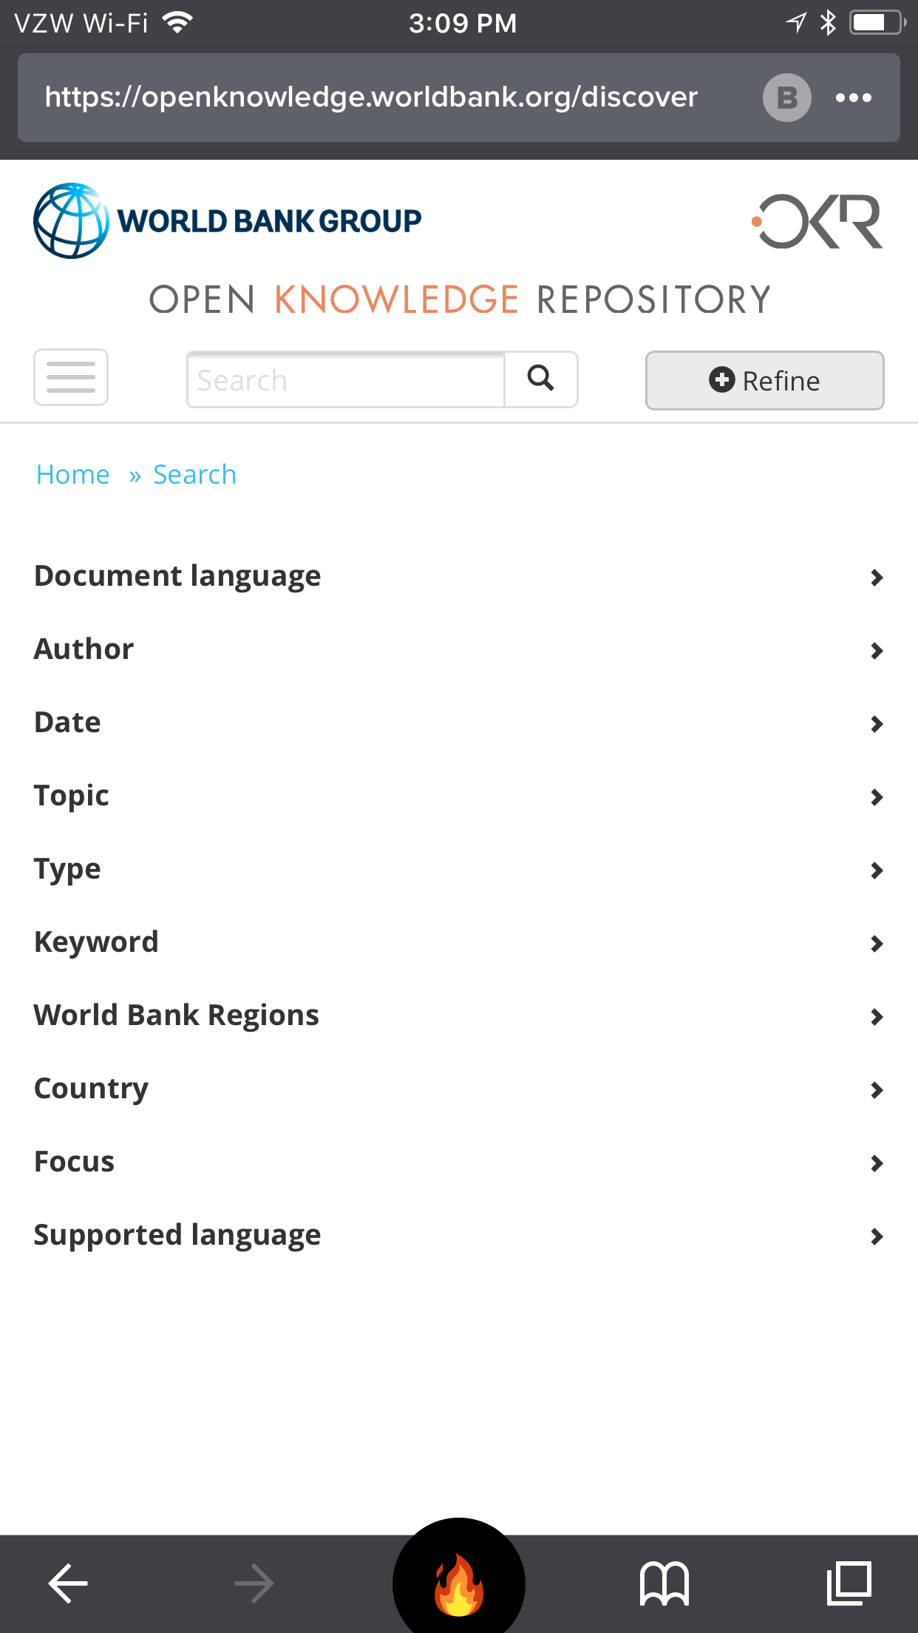
Notes:
Let’s explore the World Bank Open Knowledge Repository. It’s on the open e-resources page. It’s from the World Bank and hosts their publications and data. I’m interested in reports about agriculture in Kenya.

Slide 78
Notes:
or I can use advanced search

Slide 79
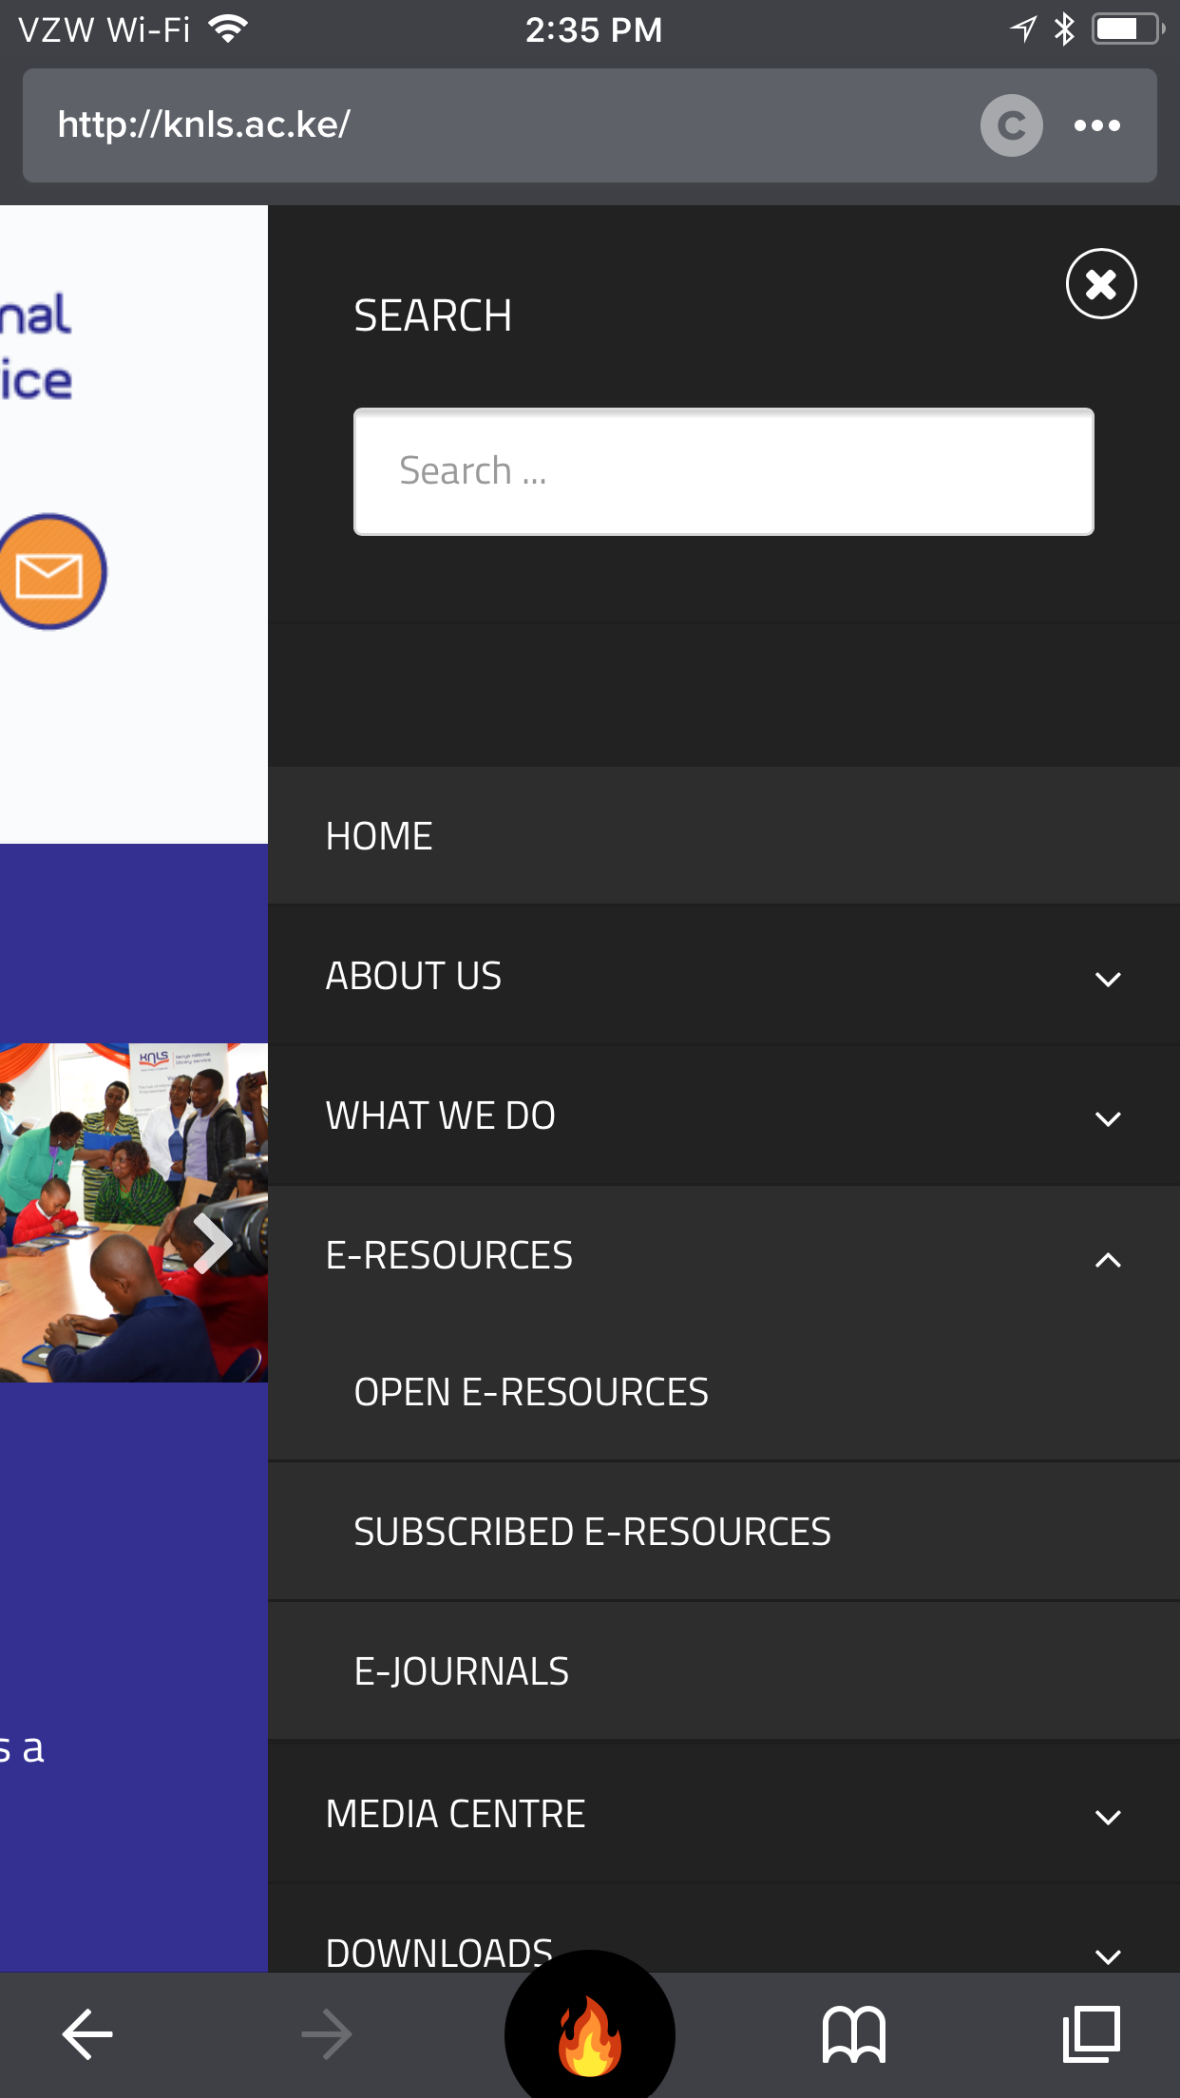
Notes:
Now it’s your turn. Explore the KNLS e-resources. See what’s available. What’s open. What’s not. How difficult it’s to explore the sites on your phone.
Open a few and review them with the participants. Does this look credible? Where is the source from? When was it published? How do the type of sources influence what search terms you use?

Slide 80
What did you learn?

Slide 81
Debrief
Thinking about the entire Mobile Information Literacy curriculum, write down
Something you learned
Something you’ll do in the next three months using what you learned
Label the paper with your name and email address. We will follow up!
Notes:
Briefly review key concepts identified, pause to answer any questions.
Explain that concludes our formal lessons in the workshop. After this last activity, we’ll host an informal “help desk” until the end of the day. You can use it as a time to ask questions and get help on any of the topics from your classmates or instructors.
Say that we’ve covered a lot of ground in the last couple of days. Before we go, think of something you learned and something you’ll do after the workshop is over. Write these down and then share with a partner.
After they’ve had time to share with a partner, ask if anyone wants to share with the rest of the group.

Slide 82
Evaluation & help desk

Slide 83
Thank You!
Stacey: staceyaw@uw.edu
Karah: karah.Lothian@gmail.com
Twitter: @TASCHAGroup
Facebook: Technology & Social Change Group
Technology & Social Change Group
tascha.uw.edu
+1.206.616.9101
Email: tascha@uw.edu

