Slide 1
MOBILE INFORMATION LITERACY CURRICULUM Module 2 Slides: A Mobile Lens on the Internet

Slide 2
These slides accompany the Mobile Information Literacy Curriculum:
Module 2 Guide: A Mobile Lens on the Internet
About the Curriculum
As millions of people come online across the globe through mobile devices, mobile information literacy is vital for those who have leapfrogged from traditional media to digital devices that provide instant access to information. Mobile information literacy is necessary to help people learn how to find and evaluate the quality and credibility of information obtained online, understand how to create and share online information effectively, and participate safely and securely. Mobile information literacy is critical to help people better consume, generate, and disseminate trustworthy information through both digital and traditional media.
The curriculum focuses on critical thinking in a digital environment of smart phones, mobile phones, and tablets, filling a critical gap in digital information literacy curricula. Existing curricular models assume people learn on a personal computer (PC). While this has been the case historically, the next billion people coming online will most likely learn on a mobile device. This has huge implications for how people get online, how they access and experience the internet, how much they produce in addition to consume information, and even how they conceptualize the internet itself. For instance, research shows that in Myanmar (and many other countries) more people use Facebook than the internet. Mobile-specific practices, such as zero-rating, mean people are coming online much more frequently through a handful of “walled garden” applications without an understanding of and similar access to the broader internet. Also, some mobile applications and websites don’t offer the full functionality of their PC counterparts. The curriculum aims to address these differences and empower mobile internet users to be equal participants in the online world.
• Module 1: Introduction to Mobile Information and Communication Technologies (ICTs)
• Module 2: Introduction to the Mobile Internet
• Module 3: Basic Web Searching via Mobile Devices
• Module 4: Working Online and Using Information via Mobile Devices
• Module 5: Putting It All Together
• Module 6: Module 5 Project Presentations
More information about this curriculum can be found here: http://tascha.uw.edu/mobile-information-literacy-curriculum
The curriculum materials are offered here with a Creative Commons Attribution-ShareAlike 3.0 license, so others are free to use, adapt, and share the materials with attribution. We are also available to help organizations create customized materials based on their particular country or regional contexts and literacy training needs.
If you have questions on the curriculum or would like more information on how we can help, please email us at tascha@uw.edu. We also encourage individuals and organizations that use and adapt this curriculum and training to provide us with any feedback, ideas, and adapted materials. There are many ways you can do this: email tascha@uw.edu, leave a comment and upload materials on the main Mobile Information Literacy curriculum webpage http://tascha.uw.edu/mobile-information-literacy-curriculum, and/or participate on our Facebook page https://www.facebook.com/MobileInformationLiteracy.
Recommended Citation
Day, S. (2015). Mobile Information Literacy Curriculum Module 2 Guide: A Mobile Lens on the Internet. Seattle: Henry M. Jackson School of International Studies & the Technology & Social Change Group, University of Washington Information School.

Slide 3
Module 2 Description
A Mobile Lens on the Internet
This module covers a brief overview of the development and evolution of the internet, the World Wide Web, and browsers. By the end of this module, participants will have a basic understanding of the internet and the World Wide Web.
Prerequisites:
Module 1: Introduction to Mobile Information & Communication Technologies (ICTs)

Slide 4
Outline
Module overview
Intro to the Internet
Intro to the World Wide Web
Web browsers
Break
Activity 2.1: Identifying Browser Elements & Navigation
Activity 2.2: Search the Web Across Platforms
Activity 2.3: Hyperlinks and Hypertext
Activity 2.4: Tabs and Bookmarks

Slide 5
Module 2 Overview
Topics covered:
Development and evolution of the internet, the World Wide Web, and web browsers
Questions you will be able to answer at the end of this module:
What is the internet?
What is the World Wide Web?
What is the difference between the internet and the web?
How do I find information on the internet?
What are the advantages and disadvantages of the different ways to find information on the web?
How do I save and share information that I find on the web?
Duration of module:
1 hour, 20 minutes (80 minutes)

Slide 6
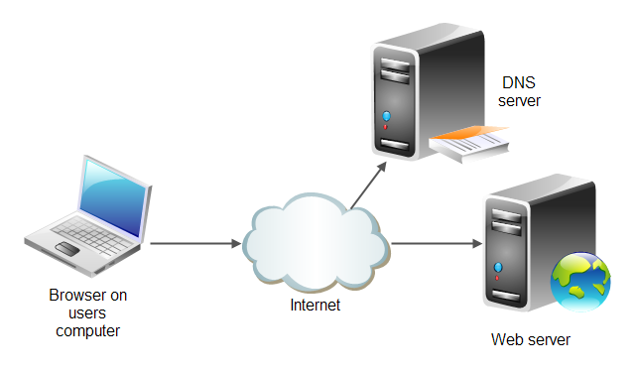
What is the Internet?
Multimedia
server
Network of Networks
that forms an information infrastructure
FTP
server
Mail
server
RTC
server
??
Image source: http://tutorials.jenkov.com/html4/the-web.html

Slide 7
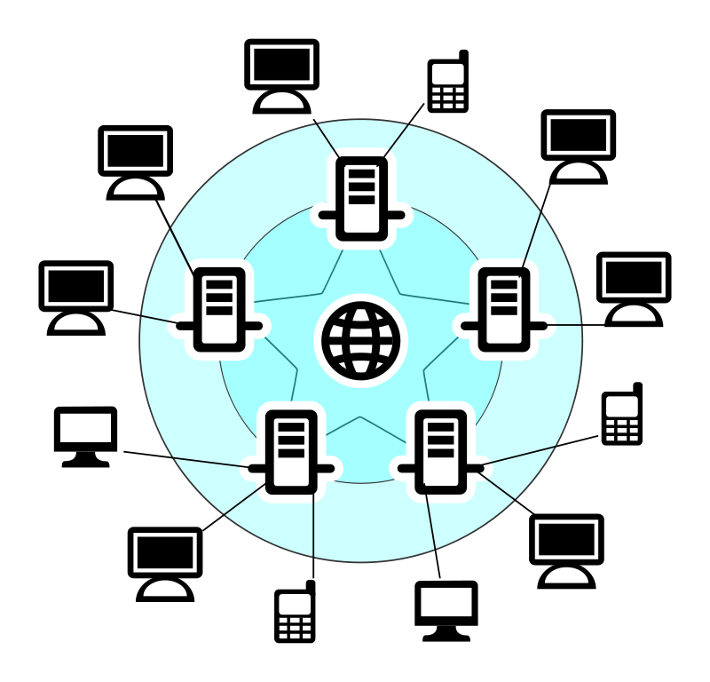
The Internet is a Network of Networks
The internet is a Network of Networks that forms an information infrastructure
Image source: Clip Art Panda (http://www.clipartpanda.com/clipart_images/internet-scheme-3412815)

Slide 8
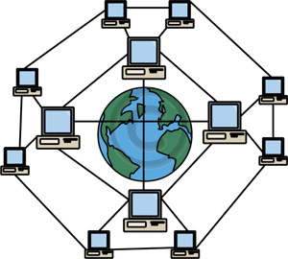
How are Networks Connected?
Image source: Clip Art Panda (http://www.clipartpanda.com/clipart_images/classroom-clipart-3410911)

Slide 9
Undersea Cable Network
Allows for global exchange of information on the International Network
Inter
Net
Image source: New Scientist (http://www.newscientist.com/data/images/ns/cms/mg20227062.200/mg20227062.200-7_3000.jpg)

Slide 10
What is the World Wide Web?
The World Wide Web (or Web, for short) is one way of accessing and visualizing information on the Internet.
HTTP (Hypertext Transfer Protocol)
Example:
http://www.facebook.com

Slide 11
World Wide Web
Multimedia
server
FTP
server
Mail
server
RTC
server
HTTP
Image source: http://tutorials.jenkov.com/html4/the-web.html

Slide 12
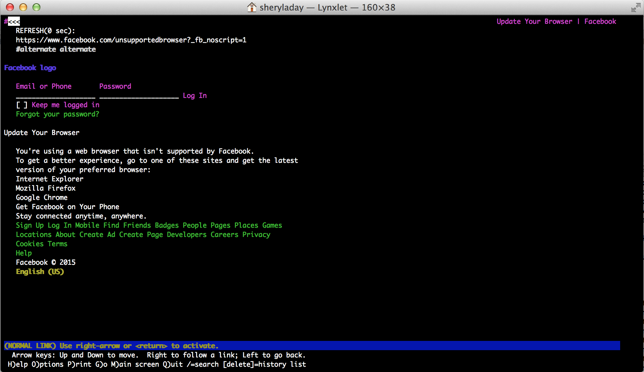
The Web Before…CLI
Facebook using the Command Line Interface

Slide 13
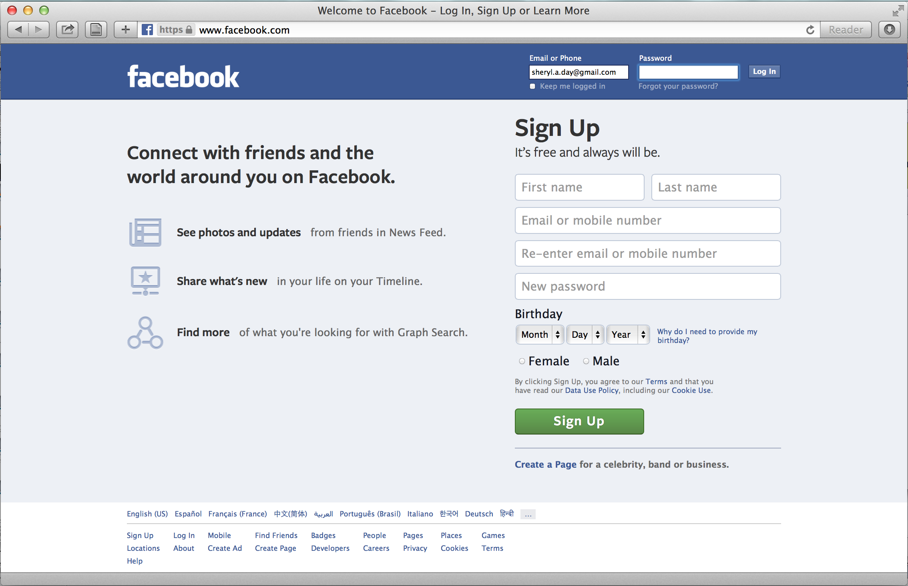
The Web After…Web Browsers
Facebook using a Web Browser

Slide 14
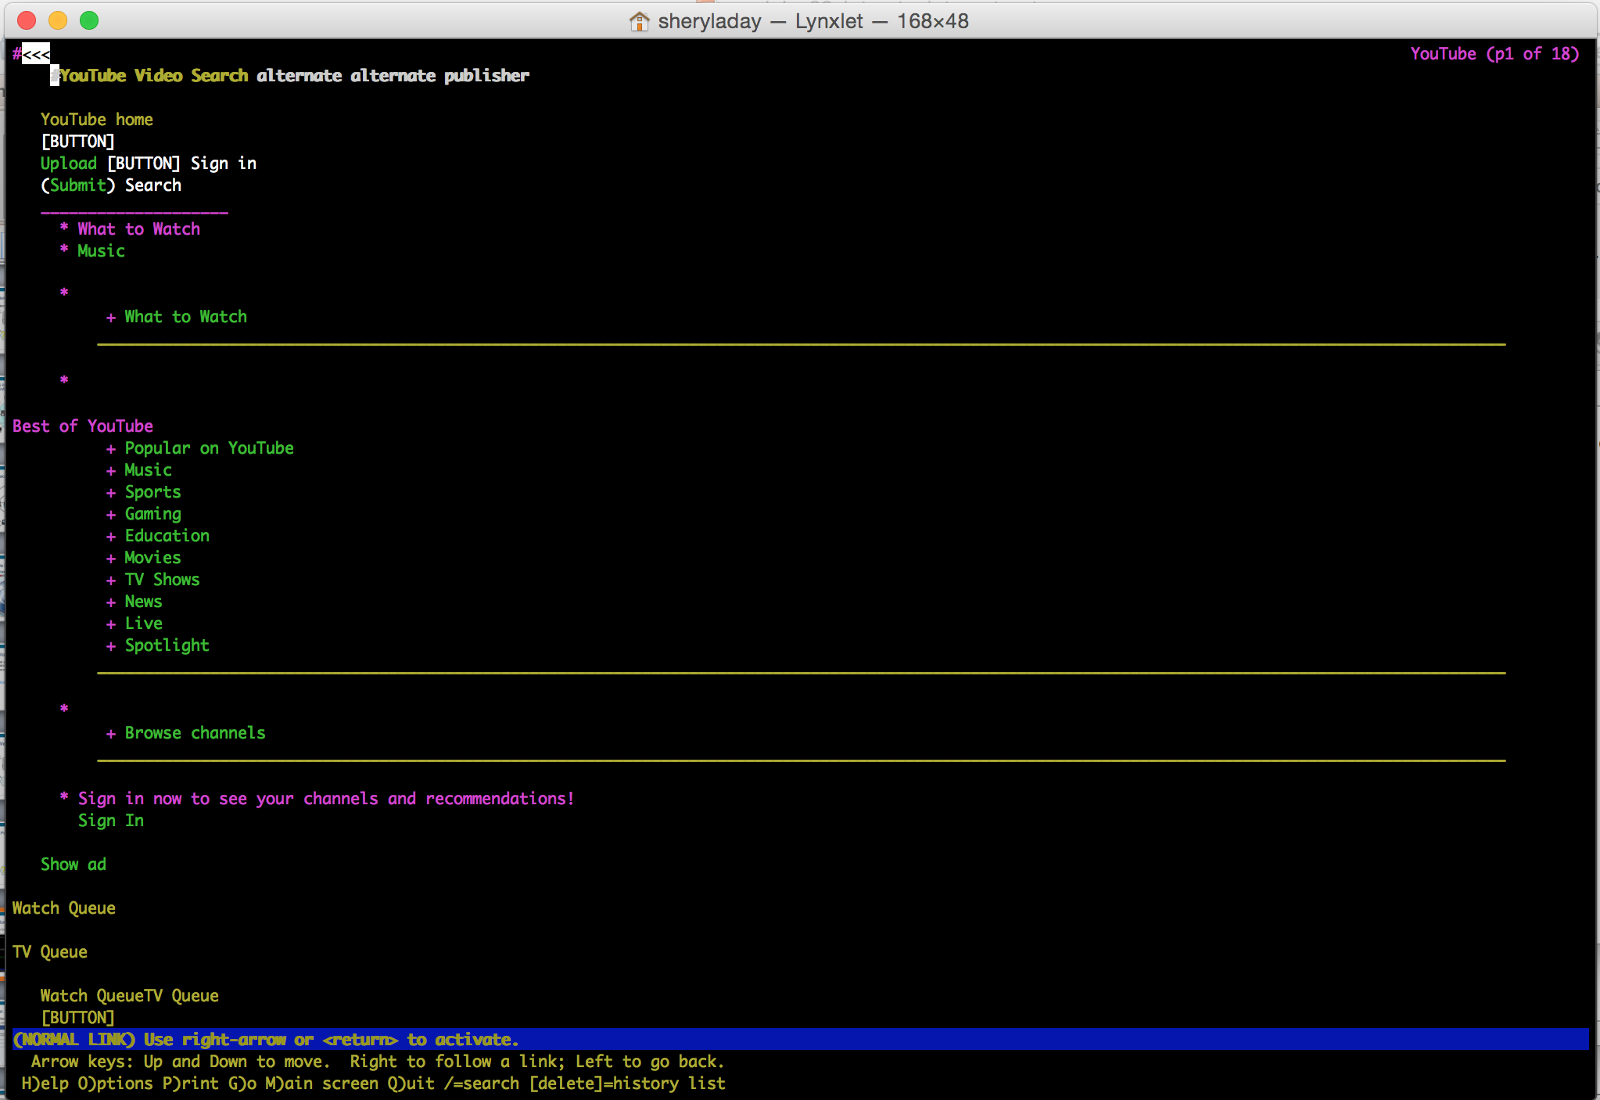
The Web Before…CLI
YouTube using the Command Line Interface
[click to show text and animation]

Slide 15
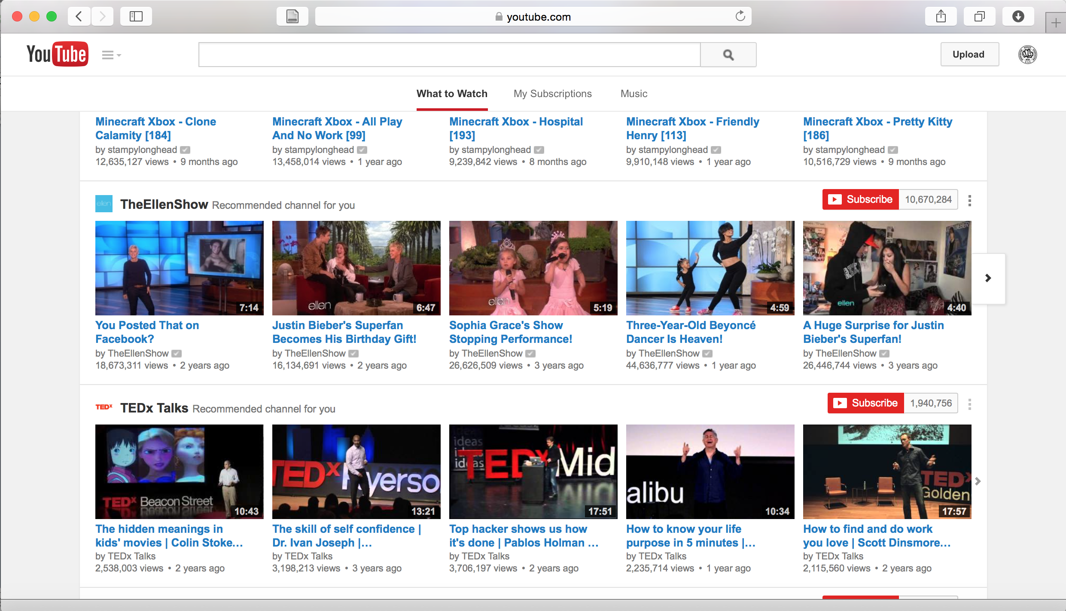
The Web After…Web Browsers
YouTube using a Web Browser

Slide 16
Web Browsers
Common Web Browsers:
Internet
Explorer
Google
Chrome
Opera
Safari
Firefox

Slide 17
Break: 5 Minutes

Slide 18
Activity 2.1: Browser Navigation
Demo: General navigation elements in desktop browser
Group Work
Identify the following elements in various browsers:
Tabs
Address / Search Bar
Navigation Swipe / Buttons (Forward & Back)
Refresh
Scroll bars
Bookmarks
Sidebar

Slide 19
Activity 2.2: Browsers Across Platforms
Demo: Searching on the web
Group Work:
Open Facebook in a browser and app on your devices. Compare your search results across these platforms
What did you notice about your search results?

Slide 20
Activity 2.3: Hypertext and Hyperlinks
Hyperlinking makes the web a very powerful system
Hyperlinks vs. Hypertext
Group Work:
Open a Link Hyperlink / Hypertext
Identify Hyperlinked information using Hypertext
Share / receive Hyperlinked information using Hypertext

Slide 21
Activity 2.4: Tabs and Bookmarks
Demo: Tabs and bookmarks using desktop browsers
Single
Tabbed
Group Work:
Save 3-5 bookmarks on your device browser
Close your browser completely
Reopen your browser and open your bookmarks
What differences do you note from the demo?

Slide 22
Review
Topics Covered:
Development and evolution of the Internet, the World Wide Web, and Web browsers
Concepts Learned:
What is the Internet?
What is the World Wide Web?
What is the difference between the Internet and the Web?
How do I find information on the Internet?
What are the advantages and disadvantages of the different ways to find information on the Web?
How do I save and share information that I find on the Web?

Slide 23
End of Module 2
Congratulations!!!
You have completed Module 2: A Mobile Lens on the Internet

Slide 24
This is a product of the Information Strategies for Societies in Transition program. This program is supported by United States Agency for International Development (USAID), Microsoft, the Bill & Melinda Gates Foundation, and the Tableau Foundation. The program is housed in the University of Washington's Henry M. Jackson School of International Studies and is run in collaboration with the Technology & Social Change Group (TASCHA) in the University of Washington’s Information School, and two partner organizations in Myanmar: the Myanmar Book Aid Preservation Foundation (MBAPF) and Enlightened Research Myanmar (EMR).

